Slide 1
Benchmarking of Graph Databases – Suitability for the Industrial Internet of Things
Bachelor’s Thesis – Final Presentation
Christian Navolskyi – 9th May 2018
https://www.unbelievable-machine.com/wp-content/uploads/2015/05/i40_2-bitkom.jpg

Slide 2
Overview
Motivation
Related Work
Databases
Design
Data Structure
Benchmark
Execution
Evaluation
Throughput
Suitability
Responsiveness
Summary

Slide 3
Motivation
Background
Transition to Industry 4.0 yields a lot of data
Data from every production machine and more
Problem
Databases are needed to store that data
Difficult to decide which database is suitable
Graph databases could be a solution
Solution
Evaluate them with a benchmark
Machine
Produced_by
Produced
Component
Notes:
Data should be stored for evaluation
Database needed that can withstand the load
Motivate graph databases

Slide 4
Related Work
Graph database benchmarks already exist
XGDBench^{[1]}
Focus on social network graphs
Workloads not insert oriented
Graphalytics^{[2]}
Focus on social network graphs
Algorithm based workloads
H.T. Shen et al.^{[3]}
R-MAT -> Social network
[1] Miyuru Dayarathna and Toyotaro Suzumura. „XGDBench : A Benchmarking Platform for Graph Stores in Exascale Clouds". In: (2012), pp. 363-370.
[2] Mihai Capota et al. „Graphalytics". In: Proc. GRADES'15 - GRADES‘15 (2015), pp. 1-6. doi: 10.1145/2764947.2764954.
[3] H.T. Shen et al. (Eds.): WAIM 2010 Workshops, LNCS 6185, pp. 37–48, 2010.

Slide 5
Databases
Many graph databases available
Neo4j, Apache Jena, Hexastore, AllegroGraph, SW-Store, BrightstarDB, LevelGraph, OrientDB, Sparksee
Our selection:
Apache Jena^{[1,3]}, Neo4j^{[1,2,3]}, OrientDB^{[1]}, Sparksee^{[3]}
[1] Miyuru Dayarathna and Toyotaro Suzumura. „XGDBench : A Benchmarking Platform for Graph Stores in Exascale Clouds". In: (2012), pp. 363-370.
[2] Mihai Capota et al. „Graphalytics". In: Proc. GRADES'15 - GRADES‘15 (2015), pp. 1-6. doi: 10.1145/2764947.2764954.
[3] H.T. Shen et al. (Eds.): WAIM 2010 Workshops, LNCS 6185, pp. 37–48, 2010.
Notes:
Well documented Java API
Were used in other research

Slide 6
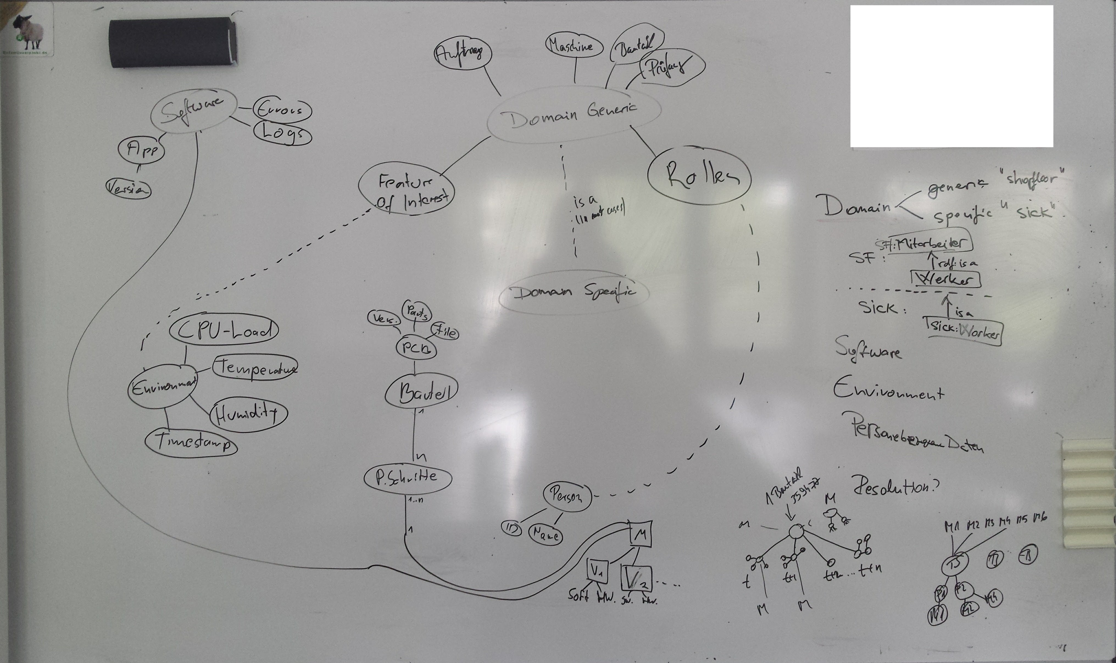
Design - Data Structure
Formative study

Slide 7
Design - Data Structure
Redesigned with knowledge from formative study and example data
1..x, 1..y, 1..z
Structural changes at these levels
Notes:
Variables x, y, z to investigate if structure has an impact

Slide 8
Design - Data Structure
Redesigned with knowledge from formative study and example data
1..x, 1..y, 1..z
Structural changes at these levels
Product
Product
Component
Component
Component
Component
Component
Tests
Tests
Tests
Tests
Tests
Test Parameter
Test Parameter
Test Parameter
Test Parameter
Test Parameter
Notes:
Variables x, y, z to investigate if structure has an impact

Slide 9

Design – Benchmarking Workloads
Throughput
Variable dataset size
With/without index
Variable data size
General capability
Industrial Suitability
Calculated dataset size
in specific time frame
Suitability to store data from production
Responsiveness
Read and scan operations
under load
Ability to retrieve data during production
Notes:
Throughput: ops/sec

Slide 10
Design – Suitability Workload
Dataset for industrial suitability
One order is fulfilled every three minutes
x = 64
y = 128
z = 128
1.056.833 nodes/3min
2.113.794 elements/3min
11.743 inserts/sec

Slide 11
Design - Benchmark
Yahoo! Cloud Service Benchmark^{[4]}
Graph DB client
Graph Workload
Workload files
Graph Generator
[4] Yusuf Abubakar et al. „Performance Evaluation of NoSQL Systems using YCSB in a Resource Austere Environment". In: Int. J. Appl. Inf. Syst. 7.8 (2014), pp. 23-27. issn: 22490868. doi: 10.5120/ijais14-451229.
Notes:
YCSB: large community, Java, well documented

Slide 12
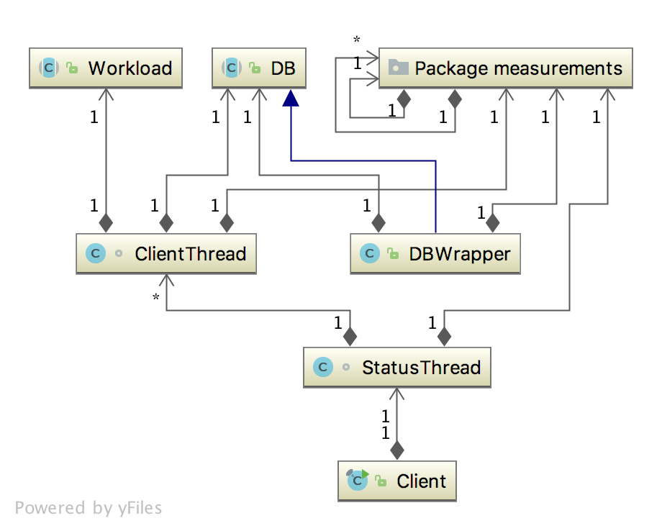
Design - Benchmark

Slide 13
Execution

Slide 14
Evaluation - Throughput
With Index
Notes:
Throughput over different dataset sizes
Insert is inserting nodes and edges, for edges two nodes have to be looked up
Apache and Neo4j where very low in throughput, maybe they worked on the main storage instead of the memory
Not tested with more because took too long
OrientDB seems to warm up at around 1.000.000 nodes
Sparksees free license only supports 1.000.000 elements
Performs best from the beginning.
Over target throughput of ~12.000 inserts/sec

Slide 15
Evaluation - Throughput
With Index
Notes:
Almost linear growth

Slide 16
Evaluation - Throughput
Without Index
Notes:
Almost no difference to index
Sparksee suffers heavily without an index, because edge insertions need to look up start and end node.

Slide 17
Evaluation - Throughput
With and without index

Slide 18
Evaluation - Throughput
Node size
Notes:
Growing node size with 10.000 nodes in total
No changes until 10KB
OrientDB can't handle large nodes.

Slide 19
Evaluation - Suitability
Structure
Notes:
The structure mentioned in the design
Simple is x = 1, y = 1, z = 1
More Complex is x = 16, y = 32, z = 32
Most Complex is x = 64, y = 128, z = 128
Almost no difference, OrientDB performs slightly worse with the high complexity, as do Apache Jena and Neo4j.

Slide 20
Evaluation - Responsiveness
Read with and without index
Notes:
Reading with and without an index.
Neo4j and OrientDB only show a slight improvement with an index.
Sparksee really benefits from using an index.

Slide 21
Evaluation - Responsiveness
Scan with and without index
Notes:
Scan operations with and without an index
Do benefit a little bit.
Traversal is not effected by the index, only the first read operations makes a difference.

Slide 22
Evaluation - Responsiveness
Operations
Notes:
Throughput of the different operations
As Neo4j is not good in inserting data, it exceeds the others in traversal.
Sparksee is the fastest in both inserting and reading data, but has weaknesses in traversal.

Slide 23
Conclusion
For our test scenario the tested databases are not suitable
Apache Jena and Neo4j
Not suitable for insert applications
OrientDB and Sparksee
Performed well
Other structure parameters would lead to less throughput necessary
OrientDB can take slightly less than 10.00 inserts/sec with other operations
Sparksee withstands around 10.000 inserts/sec with other operations
Notes:
Graph databases are not suitable,
at least for our test size.
Sparksee which could succeed was limited by its license.
Jena and Neo4j are not suitable for insert applications.
OrientDB reaches a throughput of around 1.500 inserts/sec when other operations are used regularly.
Sparksee archives a throughput of over 10.000 inserts/sec, at least for smaller dataset sizes.

Slide 24
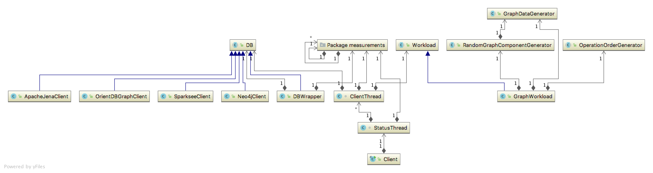
Backup: Implementation
Databases
Used Java API
GraphDataGenerator
Gson serialiser and deserialiser to store graph data
Notes:
Generators store content in files and recreate it from there

Slide 25
Backup: Execution
Hardware
Intel i7-3770K @ 3.5GHz
16GB DDR3 RAM @ 1600MHz
400GB Partition of a 2TB Drive with 5900rpm
(GTX 670)
Software
Ubuntu 17.10
YCSB 0.14.0-SNAPSHOT with our implementation
Apache Jena 3.6.0
Neo4j 3.3.4
OrientDB 2.2.33
Sparksee 5.2.3

Slide 26
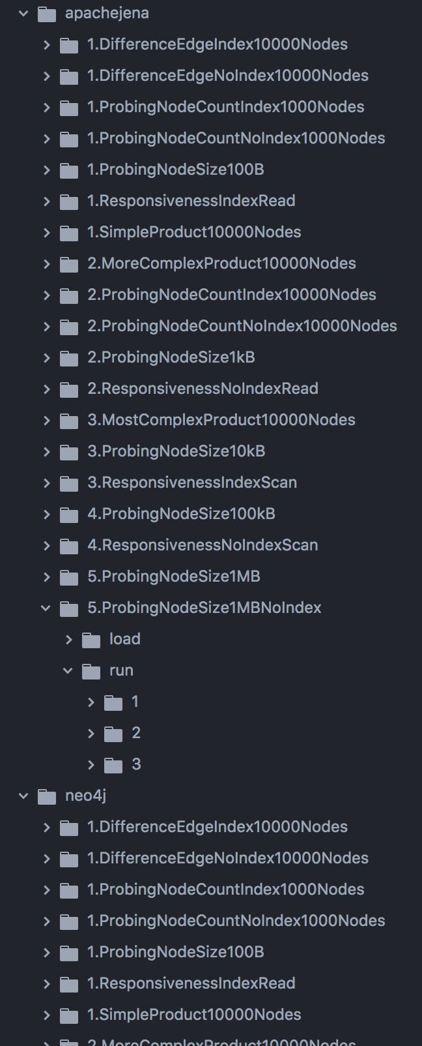
Backup: Evaluation
Results contained all measurements
Filter for operation time, database size
Calculate throughput and average

Slide 27
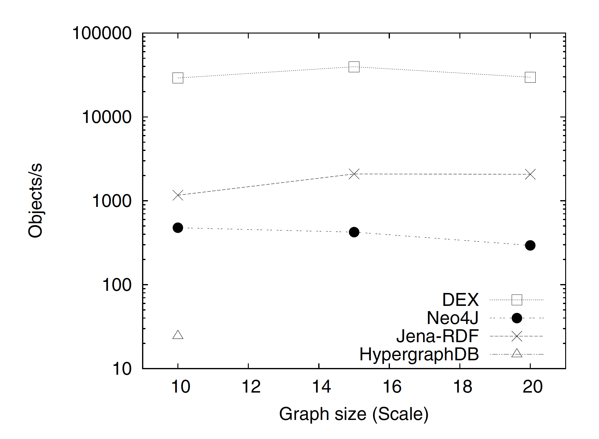
Backup: Evaluation Throughput Comparison
[3] H.T. Shen et al. (Eds.): WAIM 2010 Workshops, LNCS 6185, pp. 37–48, 2010.

Slide 28
Backup: Evaluation - Throughput
Without Index

Slide 29
Backup: Evaluation - Throughput
With and without index
Notes:
No difference except for Sparksee
Difference at larger datasets would be even bigger.

Slide 30
Backup: Evaluation - Throughput
Without edges, with and without index
Notes:
Why use no edges
To see if edges take up a lot of performance
Should show if using an index with only nodes helps in inserting nodes.
As expected, an index only adds overhead when using only nodes.

Slide 31
Backup: Evaluation - Throughput
Node size
Notes:
Database folder size for 10.000 nodes at different node sizes
Linear growth, so no large additional storage overhead, except for Neo4j, it uses around 22GB whereas the others need only around 10GB (1MB * 10.000 = 10GB)
For lower node sizes there is a big storage overhead, as they start to grow at around 10KB

Slide 32
Backup: Evaluation - Throughput
With and without edges
Notes:
Both using an index, left with edges, right without
We would expect, that throughput is higher without edges, as they need to look up nodes.
For Jena that is true, though it could be a measurement error at that low throughput.
Neo4j and OrientDB have a higher throughput with using edges, that means they can insert edges and look up nodes faster than insert new nodes.
Sparksee has no difference.

Slide 33
Backup: Evaluation - Throughput
With and without edges
Notes:
The same with more nodes.
The higher throughput is even more visible here for OrientDB.

Slide 34
Backup: Evaluation - Suitability
Execution time
Notes:
Sparksee could not complete the workload, as it only support 1.000.000 elements.
Its average up to 1.000.000 was used to calculate these results.
OrientDB is not able to reach the target throughput.
Sparksee would be if its performance stays high.

Slide 35
Backup: Evaluation - Responsiveness
Operations
Notes:
Insert throughput while using other operations
Using different operations effects insert operations negatively in all databases except Sparksee.
OrientDB shows the largest dip from only inserting to scanning.

Slide 36
Motivation
Background
Industry 4.0 yields a lot of data
Structured data needs to be stored alongside with metadata
Problem
Industry needs databases for storing data from production
Difficult to tell which database is suitable for the industrial needs of a manufacturing company
Solution
Benchmark for comparing them
With industrial data and workloads
64 boards x 128 components/board
x 128 test parameters/component x 500Byte/test parameter
= 500MB/3minutes
= 234,375GB/day
= 81TB/year
Notes:
Extreme example – in real industrial also a need to store data – small enterprise also quite some data
Unser Beispiel reinbringen
Social -> ein Knoten mit Kanten
Industry -> viele Knoten mit vielen Kanten (kleinen Baum anhängen)
Was sind die Unterschiede für Fragen. Entstehung, Updaten
Der Graph repräsentiert das implizite Wissen der Arbeiter in einer expliziten Weise.

Slide 37
Graph Motivation
Machine → node
Component → node
Production process → edge
Reasoning → more edges for easier evaluation
Machine
Produced_by
Produced
Component

Slide 38
Preparation
Search relevant databases
Neo4j, Fuseki, Jena, Hexastore, AllegroGraph, SW-Store, BrightstarDB, LevelGraph, OrientDB
Using subset of these
Evaluate existing benchmarks and their data generators
LDBC Graphalytics
XGDBench
Design
Data structure
Workloads
Data structure
Formative research
Workloads
Notes:
Es gibt Benchmarks und Datengeneratoren, aber für soziale Netze.
Wie verhalten sich die Graph Datenbanken mit Industriedaten?

Slide 39
Approach
Extend data generator
Examine key features of data structure
Extend benchmark with workloads for testing
Load = writing data
Responsiveness under load
Maximal load
Database
Database
Database
Database
Existing benchmarks
Extend data generator
Extend with workloads
Test with industry (like) data
Results for the industry

Slide 40
Evaluation
Suitability for storing live data from shop floor
Suitability for online analytics
Throughput of writing
Writing synthetic graphs
Vary workloads
Responsiveness
Analytic algorithms while under load
Time limit (latency)

Slide 41
Thank you for your attention!
Industry yields a lot of data
Needs to be stored for improvement of production
Graph structure of data
Which database is the most suitable?
Benchmark
Industrially structured data
Industrial workloads
Evaluation
Throughput
Maximal load
Responsiveness

